Slide 1
File Systems
Group 2

Slide 2
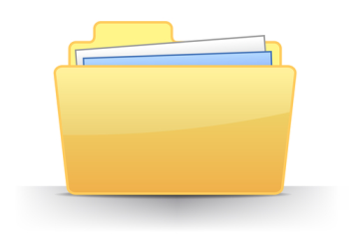
What is File System?
A file system is used to control how data is stored and retrieved.
Logic.
Speed.
Flexibility.
Security.
Size.

Slide 3
Layers of File System
Logical File Systems.
Virtual File Systems.
Physical File Systems.

Slide 4
Types of File System
File System
FAT
NTFS
REFS
EX FAT

Slide 6
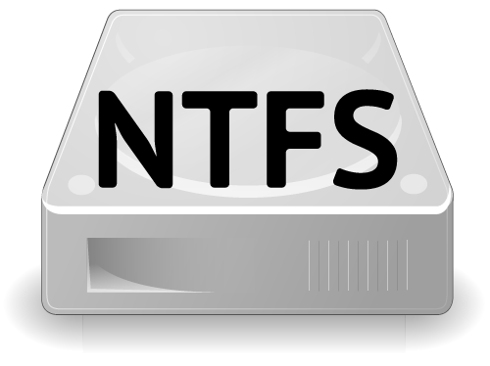
NTFS
NTFS ("New Technology File System")is a proprietary file system developed by Microsoft.
NTFS is the file system that the Windows NT operating system uses for storing and retrieving files on a hard disk.
Starting with Windows NT 3.1 in 1993, it is the default file system of Windows NT family.

Slide 7
Features
Theoretically, NTFS can support hard drives up to just under 16 EB.
NTFS supports disk usage quotas.
Encrypting File System (EFS).
Volume Shadow Copy Service (VSS).
Transactional NTFS.

Slide 8
Advantage of NTFS
There are some Windows 2000 operating system features that require NTFS.
Faster access speed. NTFS minimizes the number of disk accesses required to find a file.
Windows 2000 can format volumes up to 2 terabytes in size with NTFS.
The boot sector is backed up to a sector at the end of the volume.
NTFS supports a native encryption system called Encrypting File System (EFS), using public-key security to prevent unauthorized access to file contents.

Slide 9
Dis-advantage of NTFS
NTFS volumes are not accessible in MS-DOS, Windows 95, and Windows 98. Due to upgrades made to NTFS in Windows 2000, the advanced features of the Windows 2000 implementation of NTFS are not available in Windows NT 4.0 and earlier.
When very small volumes contain mostly small files, the overhead of managing NTFS may cause a slight performance drop in comparison to FAT.

Slide 10
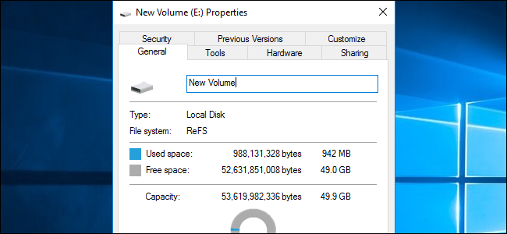
ReFS
Resilient File System (ReFS) is a type of disk file system that provides a disk storage management platform to Windows server operating systems. ReFS is also known as Protogon.

Slide 11
Key Features
Metadata integrity.
Integrity streams.
Copy on write.
Large volume, file and directory sizes.
Storage pooling and virtualization.
Data striping for performance (similar to RAID).
Disk scrubbing.
Resiliency to corruption.
Compatible with shared storage pools.

Slide 12
Maximum file name length | 255 Unicode characters
Maximum path name length | 32K Unicode characters
Maximum file size | 35 PB (petabytes)
Maximum volume size | 35 PB

Slide 13
The goals of Microsoft in building ReFS were:
Maintain a high level of compatibility with NTFS.
Make it able to verify and auto-correct data.
Optimize for extreme scale.
Make it able to stay always online, even in case of partial corruptions.
Provide a full end-to-end resiliency architecture when used in conjunction with the Storage Spaces feature.

Slide 14
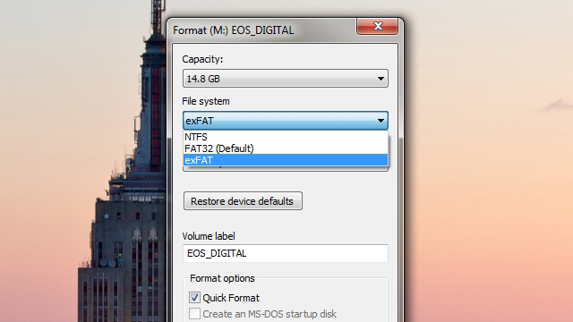
ExFAT
ExFAT (Extended File Allocation Table) is a file system designed and patented by Microsoft and released in all versions of Windows, starting with Windows Server 2008.

Slide 15
exFAT is considered the successor to the FAT16 and FAT32 file systems, and has become increasingly popular, gaining support from various third-party devices, including Western Digital hard drives.
It has a theoretical maximum disk size up to 64 ZB (Zettabytes) or 64 billion terabytes, versus a 32 GB maximum under a FAT32 partition

Slide 16
Using an external drive between Mac and Windows computers can be a hassle, since you constantly have to reformat it to fit which computer you're using it on. Instead of reformatting it all the time, just use the much more platform-independent exFAT and never format it again.
Windows' default NTFS is only readable on OS X, not writable, and Windows computers can't even read Mac-formatted HFS+ drives. FAT32 works for both OSes, but has a 4GB size limit per file, so it isn't ideal. You can always install drivers for those other OSes, but that doesn't help when you're sharing files with your friends' computers. Besides, it's kind of a hassle. The exFAT file system is a much simpler option

Slide 17
exFAT has been around for a while, but we've never really talked about it. Essentially, it's a file system that's both readable and writable on any modern Mac or Windows machine (sorry, XP users). All you need to do is format the drive on a Windows machine and you're good to go. Note that you can't format it on OS X, you have to format it on Windows for it to be compatible with both platforms. To do so, just:
1. Open up Windows Explorer and right-click on your drive in the sidebar. Choose "Format".
2. In the "File System" dropdown, choose exFAT instead of NTFS.
3. Click Start and close this window when finished.
From then on, that drive should work fantastically between Mac and Windows machines. It won't work with Linux unless you install Linux's exFAT drivers, but for most people, exFAT is just about perfect.

